Slide 1
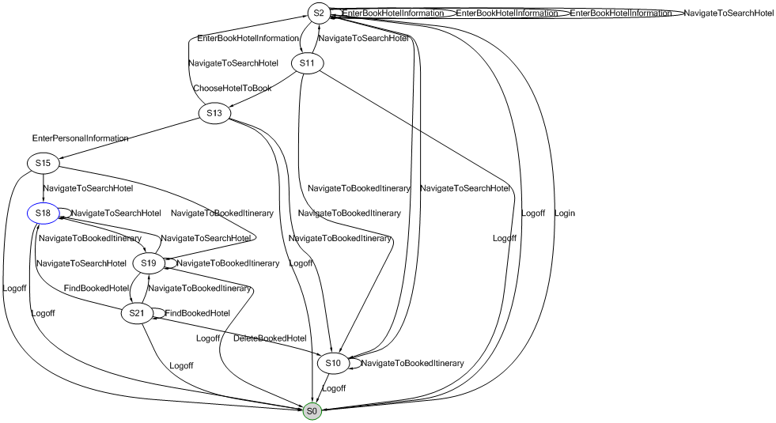
Model-based Testing with SpecExplorer and TestOptimal
Vincent van Deemter – Software Engineer
ATOS, Netherlands
17 April 2015

Slide 2
Contents
Research
Findings
Demonstration
Conclusion
Advice for Atos
Questions

Slide 3
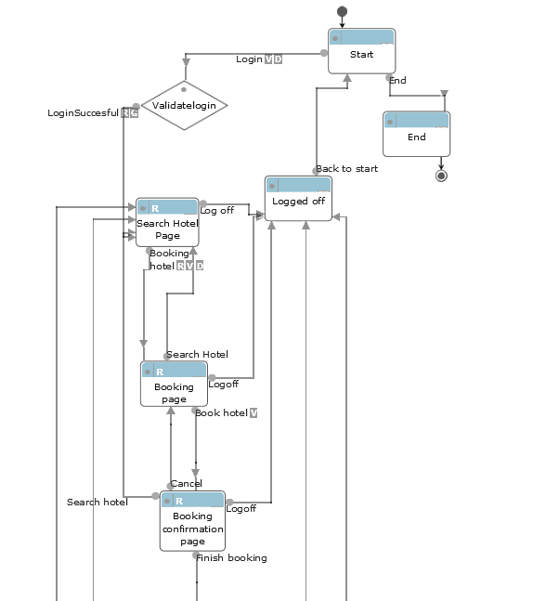
Research
History
Model-based testing
New method of automated testing
Tests are generated from a model containing the actions of the system under test
Tests simulate the use of the system
Most tools are developed by universities

Slide 4
Research
History
Model-based testing
New method of automated testing
Tests are generated from a model containing the actions of the system under test
Tests simulate the use of the system
Most tools are developed by universities
TestOptimal
Commercial tool
Small company →Continuity risk
Market research

Slide 5
Research
Microsoft Spec Explorer
Free plug-in for Visual Studio 2010/2012
Included in the TFS release calendar

Slide 6
Research
Research Question
Does Spec Exporer contain the same possibilities regarding functionality, technical aspects, commercial aspects and user friendliness and does it contain additional features which are useful for Atos?
Tool comparison
Aspects
Functional
Technical
Commercial
User friendliness
Convert TestOptimal models to be used within SpecExplorer

Slide 7
Findings
Tool comparison document by TestNet
Model Adactin HotelApp
Contact Microsoft/TestOptimal

Slide 8
Findings
 | TestOptimal
Functional | 33/43
Technical | 37/57
User Friendliness | 24/31
Commercial | 2/28
Total | 96/159
Tool comparison document score: 96/159
Model Adactin HotelApp
Advantages TestOptimal
GUI more user friendly
Better sample projects
Not bound to specific versions of Visual Studio
Better test reports
Possible to continue test execution after an assert fails
More methods to traverse a model and test applications

Slide 9
Findings
 | Spec Explorer
Functional | 21/43
Technical | 31/57
User Friendliness | 17/31
Commercial | 8/28
Total | 77/159
Tool comparison document score: 77/159
Model Adactin HotelApp
Advantages Spec Explorer
Automatically repeating functions
Free plug-in for Visual Studio 2010/2012
Tests can be extended via C#
Notes:
Functionalilteit kan makkelijker op verschillende plekken herhaald worden (Checker Pattern)

Slide 10
Findings
 | TestOptimal | SpecExplorer
Functional | 33/43 | 21/43
Technical | 37/57 | 31/57
User Friendliness | 24/31 | 17/31
Commercial | 2/28 | 8/28
Total | 96/159 | 77/159
SpecExplorer
Development of Microsoft Powertools is not guaranteed, continuity risk remains
Less extensive test reports
More complicated to use and learn
Notes:
Functionalilteit kan makkelijker op verschillende plekken herhaald worden (Checker Pattern)

Slide 11
Findings
 | TestOptimal | SpecExplorer
Functional | 33/43 | 21/43
Technical | 37/57 | 31/57
User Friendliness | 24/31 | 17/31
Commercial | 2/28 | 8/28
Total | 96/159 | 77/159
Model converting tool
Modelling of tools is done in very different ways
Developing a tool that can convert models is possible but will cost a lot of time
Notes:
Functionalilteit kan makkelijker op verschillende plekken herhaald worden (Checker Pattern)

Slide 12
Demonstration

Slide 13
Conclusion
 | TestOptimal | SpecExplorer
Functional | 33/43 | 21/43
Technical | 37/57 | 31/57
User Friendliness | 24/31 | 17/31
Commercial | 2/28 | 8/28
Total | 96/159 | 77/159
Both tools are powerful and capable for applying model-based testing
TestOptimal better for:
User friendliness
Test reports
Test execution
SpecExplorer better for:
License costs
SpecExplorer does not remove continuity risks
Model conversion tool will be very complicated and will cost a lot of time to develop.
TestOptimal is the better tool for use within Atos

Slide 14
Advice for Atos
Follow-up research other commercial MBT tools
DTM – XL Team
MBTSuite – sepp.med
Both are companies that have between 51 to 200 employees according to LinkedIn
Employee amount does not guarantee the lack of a continuity risk
Follow-up research open-source tools
Market research required
Promote TestOptimal to clients
Implement SpecExplorer in DevOps environment

Slide 15
Questions?

